Slide 1
Starting a Tax Return - TaxSlayer Basic Information
Form 13614-C Intake/Interview Form
Pub 4012 Tab N “Using TaxSlayer Pro Online”
NJ 1040 Pages 1 and 2
Notes:
1

Slide 2
TS – Personal Information about Taxpayer & Spouse
Enter information about taxpayer and spouse in Federal section \ Personal Information
Name (Spouse’s last name pre-populated based on taxpayer’s; change if necessary)
Social Security # (Taxpayer’s # populated from # used to start return)
Date of birth
Occupation
Address
Enter zip code and TaxSlayer will automatically populate city and state

Slide 3
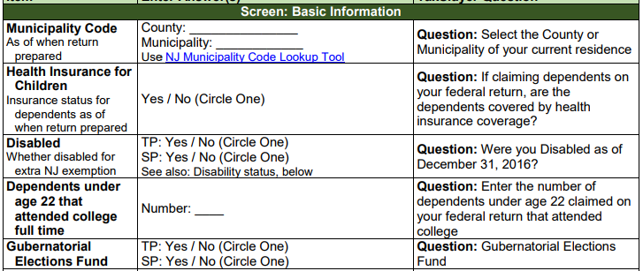
TS – Personal Information about Taxpayer and Spouse
(cont’d)
Desire to contribute to Presidential Election Fund
Note Gubernatorial Election Fund desire in the NJ Checklist Basic Information section for later entry in the TaxSlayer State section
Other situation-specific questions

Slide 4
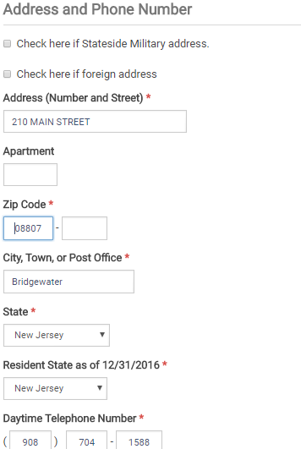
TS – Personal Exemption for Taxpayer & Spouse Basic Information Section \ Personal Information
(cont’d)
Address
Enter zip code; TaxSlayer populates city & state
Resident state as of 12/31; *
Determines which state return to file
* If no state return to complete, choose None as Resident State

Slide 5
TS – TaxSlayer Automatically Starts NJ Return
Based on Resident State as of 12/31 entry, TaxSlayer automatically starts the appropriate state return
Makes NJ refund monitor available as soon as first income entry is made
To start the NJ return, must answer 4 basic questions:
County/Municipality code
Health insurance for dependents
Gubernatorial Elections Fund
Taxpayer/Spouse PINs (created by counselor)
Notes:
TaxSlayer starts the state return as soon as Personal Information is entered. This allows you to see the NJ refund monitor as soon as you start entering income
TaxSlayer entries can almost always be made in any order. However, we recommend that you complete sections in the order of the Main Menu
As you enter data in the Federal section, note any information that may have to be changed on the NJ return due to different tax law. Capture that information on the NJ Checklist so that you don’t forget to enter it when you get to the State section
Also helpful in Quality Review process
Instructions for special fields and adjustments are given in the slides covering both federal and NJ entry for each topic

Slide 6
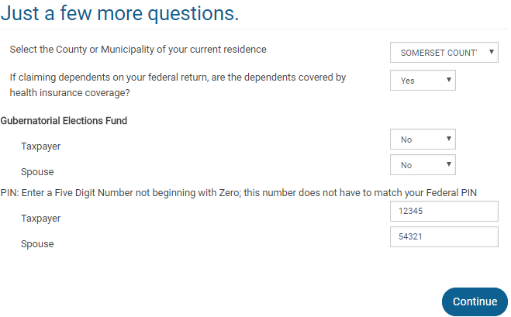
TS – Basic Questions to Start NJ Return
Municipality code
Dependents health insurance
Gubernatorial Election Fund
NJ PIN; does not have to match Federal PIN

